Slide 1
Chongqing University of Technology
ATAI
Advanced Technique of Artificial Intelligence
Chongqing University of Technology
IJCAI_2021
Hongyang Song

Slide 2
Outline
Motivation
Approach
Experiments
Conclusion

Slide 3
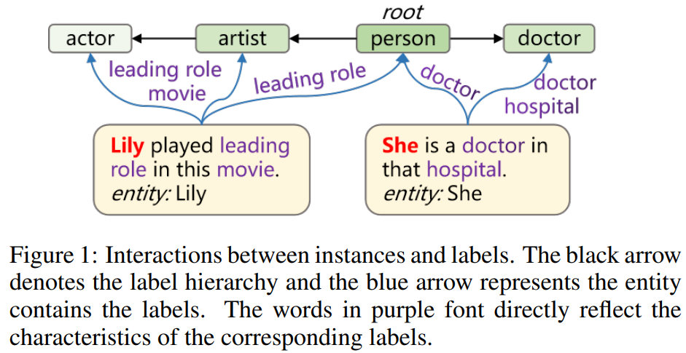
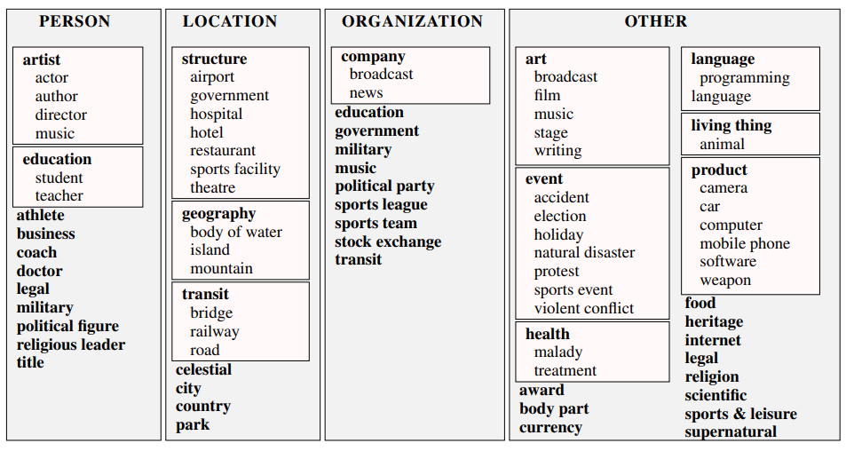
Motivation
OntoNotes

Slide 4
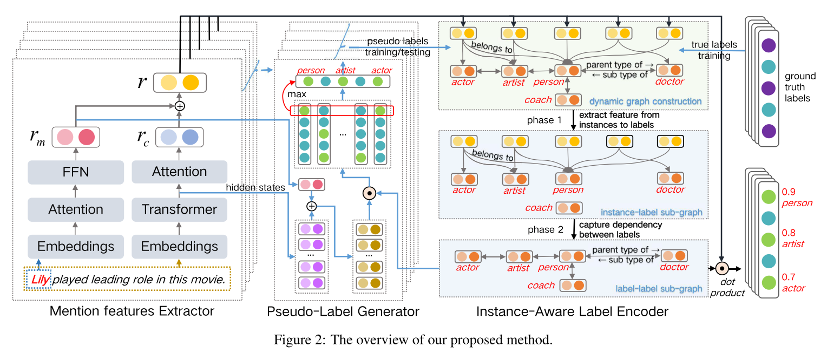
Approach

Slide 5
Approach

Slide 6
Approach

Slide 7
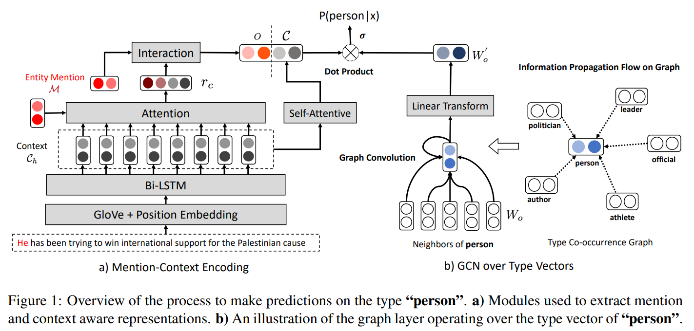
Approach
NAACL_2019_Imposing label-relational inductive bias for extremely fine-grained entity typing

Slide 8
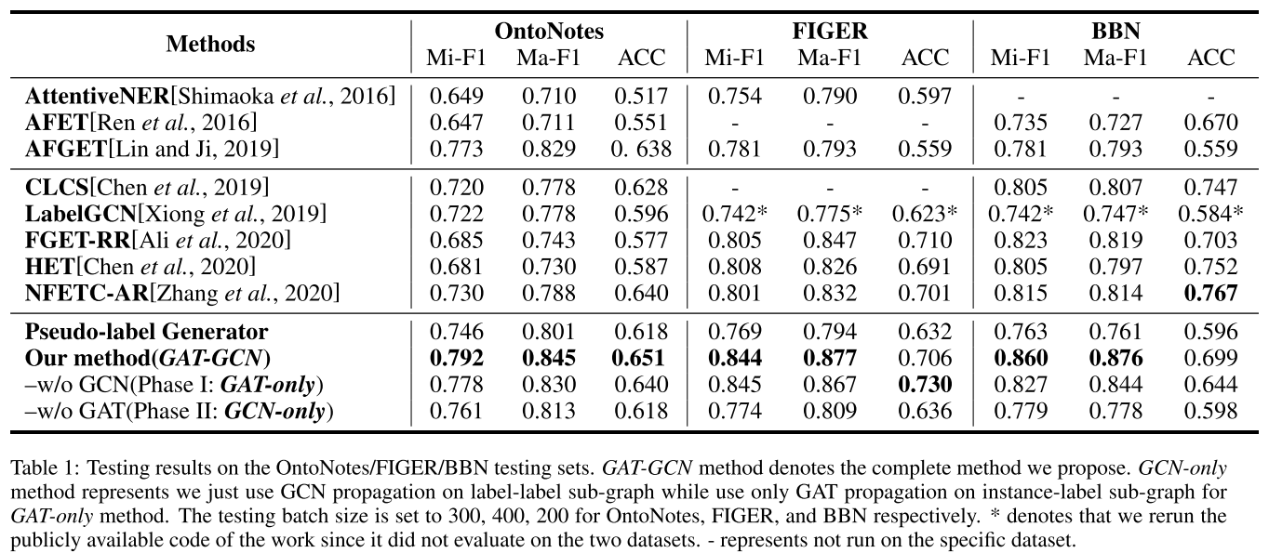
Experience

Slide 9
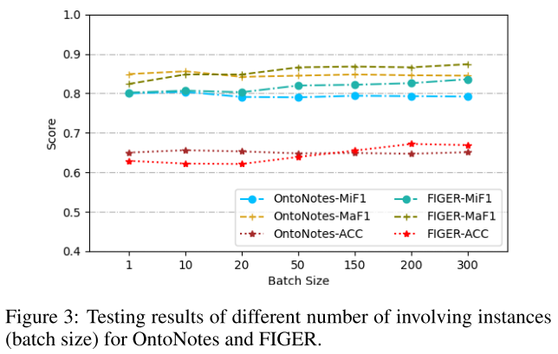
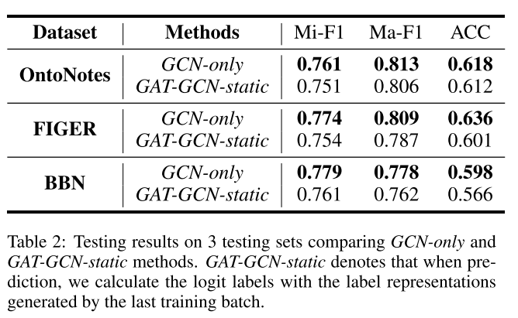
Experience

Slide 10
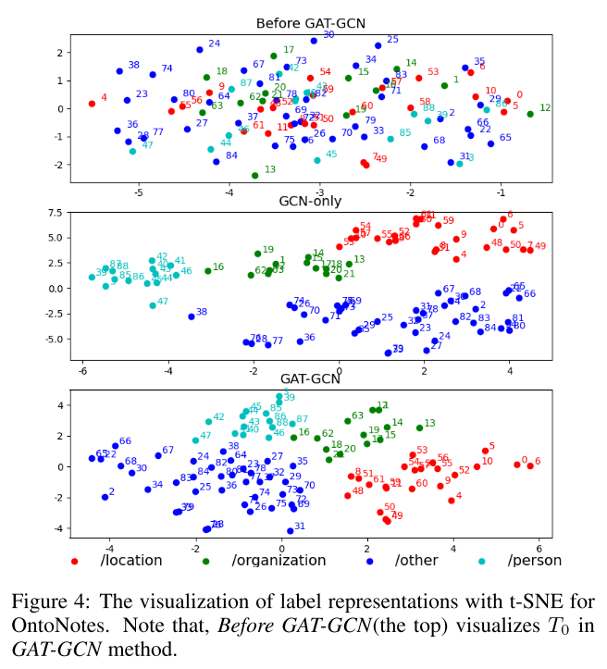
Experience

Slide 11
Thanks

